Slide 1
About homework 1
Student question:
How do you know that we are running the requested algorithm since you only check for a correct solution?
Answer:
We don’t
But you should implement all 3 algorithms so that you learn about them
We may perform random checks of your code
We will for sure check all the code of the students that are in the top 10% of speed (and hence eligible for extra credit).

Slide 2
Last time: Problem-Solving
Problem solving:
Goal formulation
Problem formulation (states, operators)
Search for solution
Problem formulation:
Initial state
?
?
?
Problem types:
single state: accessible and deterministic environment
multiple state: ?
contingency: ?
exploration: ?

Slide 3
Last time: Problem-Solving
Problem solving:
Goal formulation
Problem formulation (states, operators)
Search for solution
Problem formulation:
Initial state
Operators
Goal test
Path cost
Problem types:
single state: accessible and deterministic environment
multiple state: ?
contingency: ?
exploration: ?

Slide 4
Last time: Problem-Solving
Problem solving:
Goal formulation
Problem formulation (states, operators)
Search for solution
Problem formulation:
Initial state
Operators
Goal test
Path cost
Problem types:
single state: accessible and deterministic environment
multiple state: inaccessible and deterministic environment
contingency: inaccessible and nondeterministic environment
exploration: unknown state-space

Slide 5
Last time: Finding a solution
Solution: is ???
Basic idea: offline, systematic exploration of simulated state-space by generating successors of explored states (expanding)
Function General-Search(problem, strategy) returns a solution, or failure
initialize the search tree using the initial state problem
loop do
if there are no candidates for expansion then return failure
choose a leaf node for expansion according to strategy
if the node contains a goal state then return the corresponding solution
else expand the node and add resulting nodes to the search tree
end

Slide 6
Last time: Finding a solution
Solution: is a sequence of operators that bring you from current state to the goal state.
Basic idea: offline, systematic exploration of simulated state-space by generating successors of explored states (expanding).
Function General-Search(problem, strategy) returns a solution, or failure
initialize the search tree using the initial state problem
loop do
if there are no candidates for expansion then return failure
choose a leaf node for expansion according to strategy
if the node contains a goal state then return the corresponding solution
else expand the node and add resulting nodes to the search tree
end
Strategy: The search strategy is determined by ???

Slide 7
Last time: Finding a solution
Solution: is a sequence of operators that bring you from current state to the goal state
Basic idea: offline, systematic exploration of simulated state-space by generating successors of explored states (expanding)
Function General-Search(problem, strategy) returns a solution, or failure
initialize the search tree using the initial state problem
loop do
if there are no candidates for expansion then return failure
choose a leaf node for expansion according to strategy
if the node contains a goal state then return the corresponding solution
else expand the node and add resulting nodes to the search tree
end
Strategy: The search strategy is determined by the order in which the nodes are expanded.

Slide 8
A Clean Robust Algorithm
Function UniformCost-Search(problem, Queuing-Fn) returns a solution, or failure
open ← make-queue(make-node(initial-state[problem]))
closed ← [empty]
loop do
if open is empty then return failure
currnode ← Remove-Front(open)
if Goal-Test[problem] applied to State(currnode) then return currnode
children ← Expand(currnode, Operators[problem])
while children not empty
[… see next slide …]
end
closed ← Insert(closed, currnode)
open ← Sort-By-PathCost(open)
end

Slide 9
A Clean Robust Algorithm
[… see previous slide …]
children ← Expand(currnode, Operators[problem])
while children not empty
child ← Remove-Front(children)
if no node in open or closed has child’s state
open ← Queuing-Fn(open, child)
else if there exists node in open that has child’s state
if PathCost(child) < PathCost(node)
open ← Delete-Node(open, node)
open ← Queuing-Fn(open, child)
else if there exists node in closed that has child’s state
if PathCost(child) < PathCost(node)
closed ← Delete-Node(closed, node)
open ← Queuing-Fn(open, child)
end
[… see previous slide …]

Slide 10
Last time: search strategies
Uninformed: Use only information available in the problem formulation
Breadth-first
Uniform-cost
Depth-first
Depth-limited
Iterative deepening
Informed: Use heuristics to guide the search
Best first
A*

Slide 11
Evaluation of search strategies
Search algorithms are commonly evaluated according to the following four criteria:
Completeness: does it always find a solution if one exists?
Time complexity: how long does it take as a function of number of nodes?
Space complexity: how much memory does it require?
Optimality: does it guarantee the least-cost solution?
Time and space complexity are measured in terms of:
b – max branching factor of the search tree
d – depth of the least-cost solution
m – max depth of the search tree (may be infinity)

Slide 12
Last time: uninformed search strategies
Uninformed search:
Use only information available in the problem formulation
Breadth-first
Uniform-cost
Depth-first
Depth-limited
Iterative deepening

Slide 13
This time: informed search
Informed search:
Use heuristics to guide the search
Best first
A*
Heuristics
Hill-climbing
Simulated annealing

Slide 14
Best-first search
Idea:
use an evaluation function for each node; estimate of “desirability”
expand most desirable unexpanded node.
Implementation:
QueueingFn = insert successors in decreasing order of desirability
Special cases:
greedy search
A* search

Slide 15
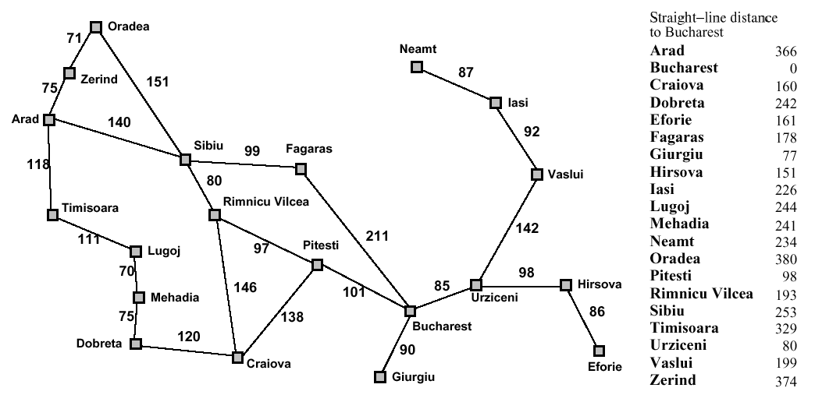
Romania with step costs in km
374
253
329

Slide 16
Greedy search
Estimation function:
h(n) = estimate of cost from n to goal (heuristic)
For example:
h_{SLD}(n) = straight-line distance from n to Bucharest
Greedy search expands first the node that appears to be closest to the goal, according to h(n).

Slide 17
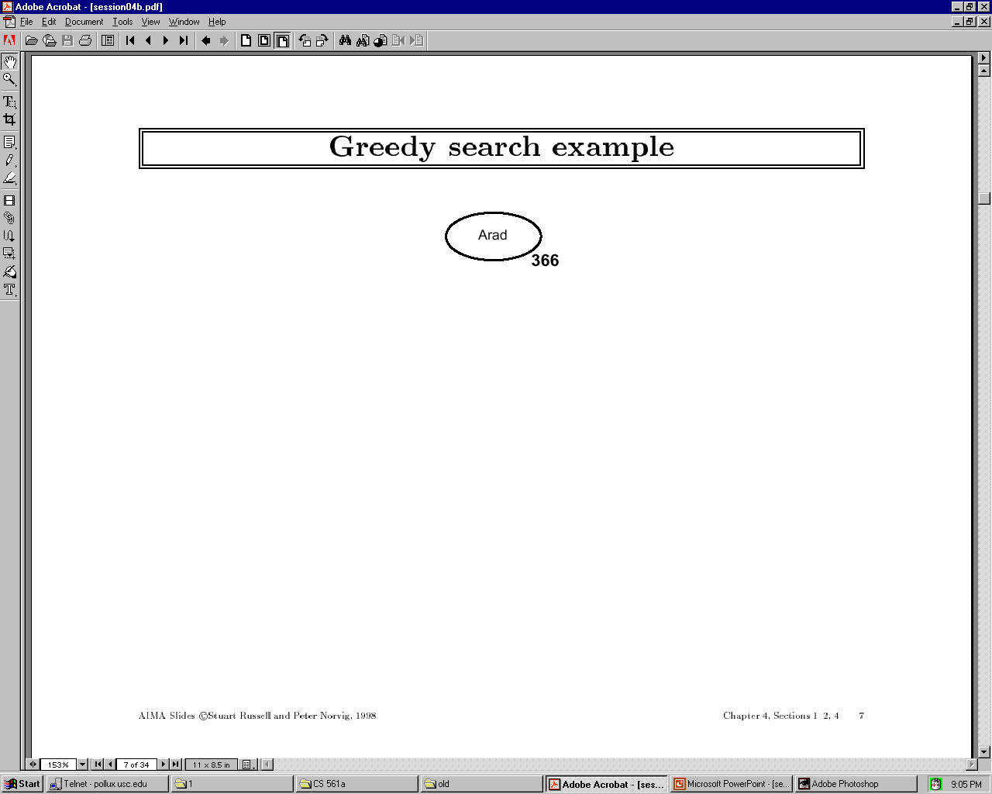

Slide 18
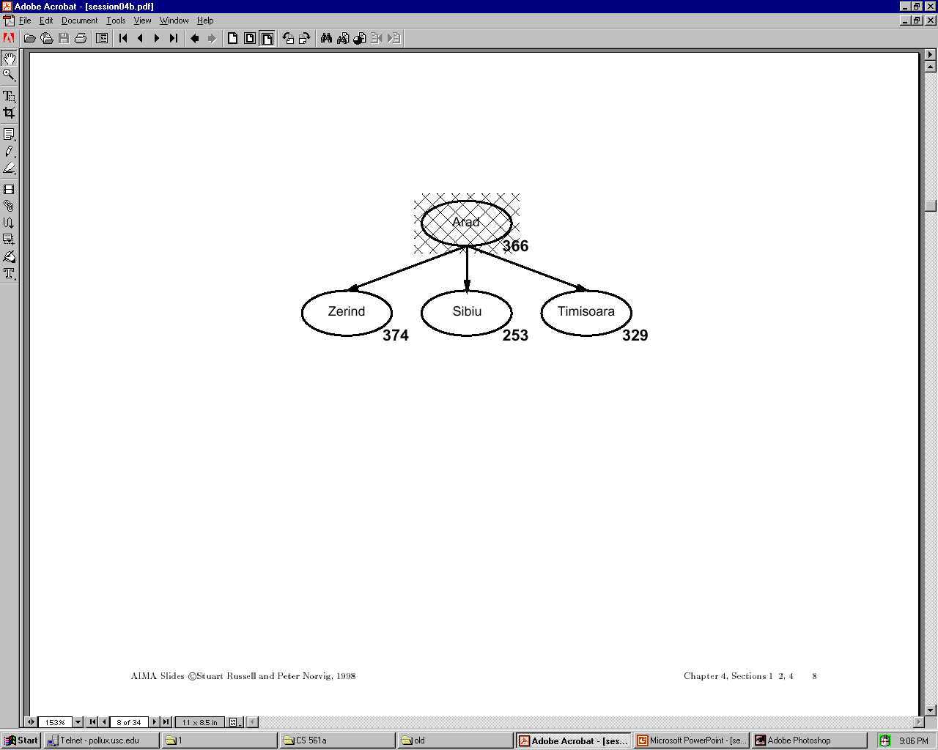

Slide 19
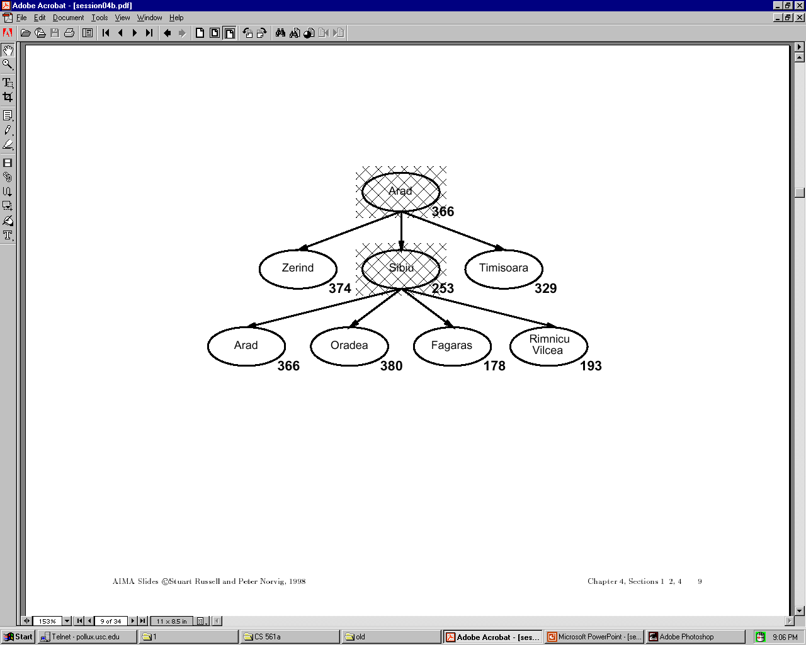

Slide 20
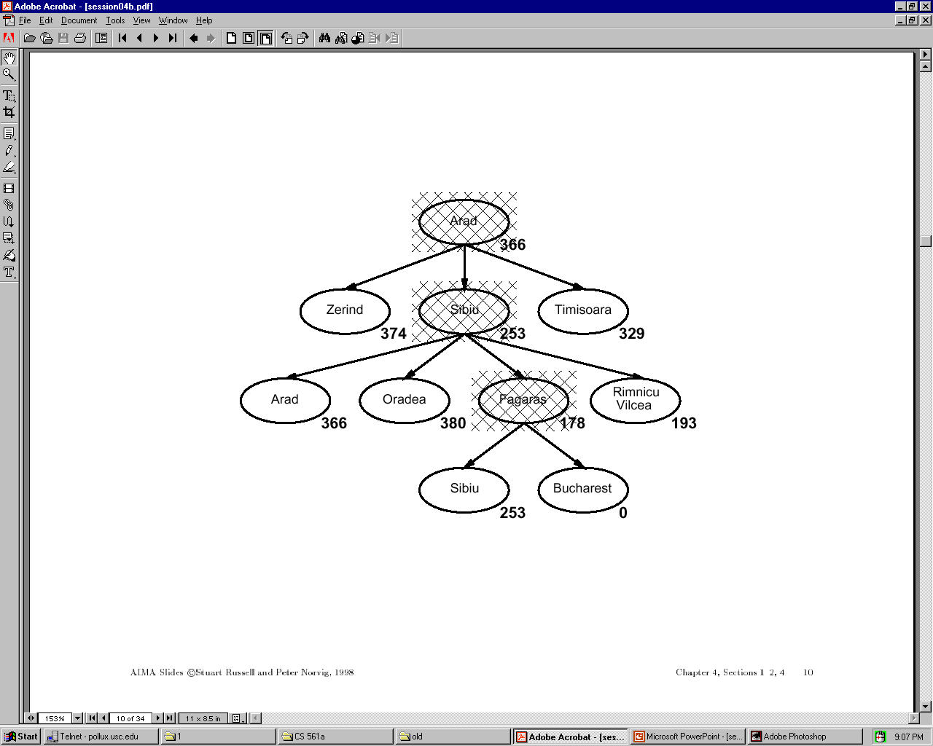

Slide 21
Properties of Greedy Search
Complete?
Time?
Space?
Optimal?

Slide 22
Properties of Greedy Search
Complete? No – can get stuck in loops
e.g., Iasi > Neamt > Iasi > Neamt > …
Complete in finite space with repeated-state checking.
Time? O(b^m) but a good heuristic can give
dramatic improvement
Space? O(b^m) – keeps all nodes in memory
Optimal? No.

Slide 23
A* search
Idea: avoid expanding paths that are already expensive
evaluation function: f(n) = g(n) + h(n) with:
g(n) – cost so far to reach n
h(n) – estimated cost to goal from n
f(n) – estimated total cost of path through n to goal
A* search uses an admissible heuristic, that is,
h(n) ≤ h*(n) where h*(n) is the true cost from n.
For example: h_{SLD}(n) never overestimates actual road distance.
Theorem: A* search is optimal

Slide 24
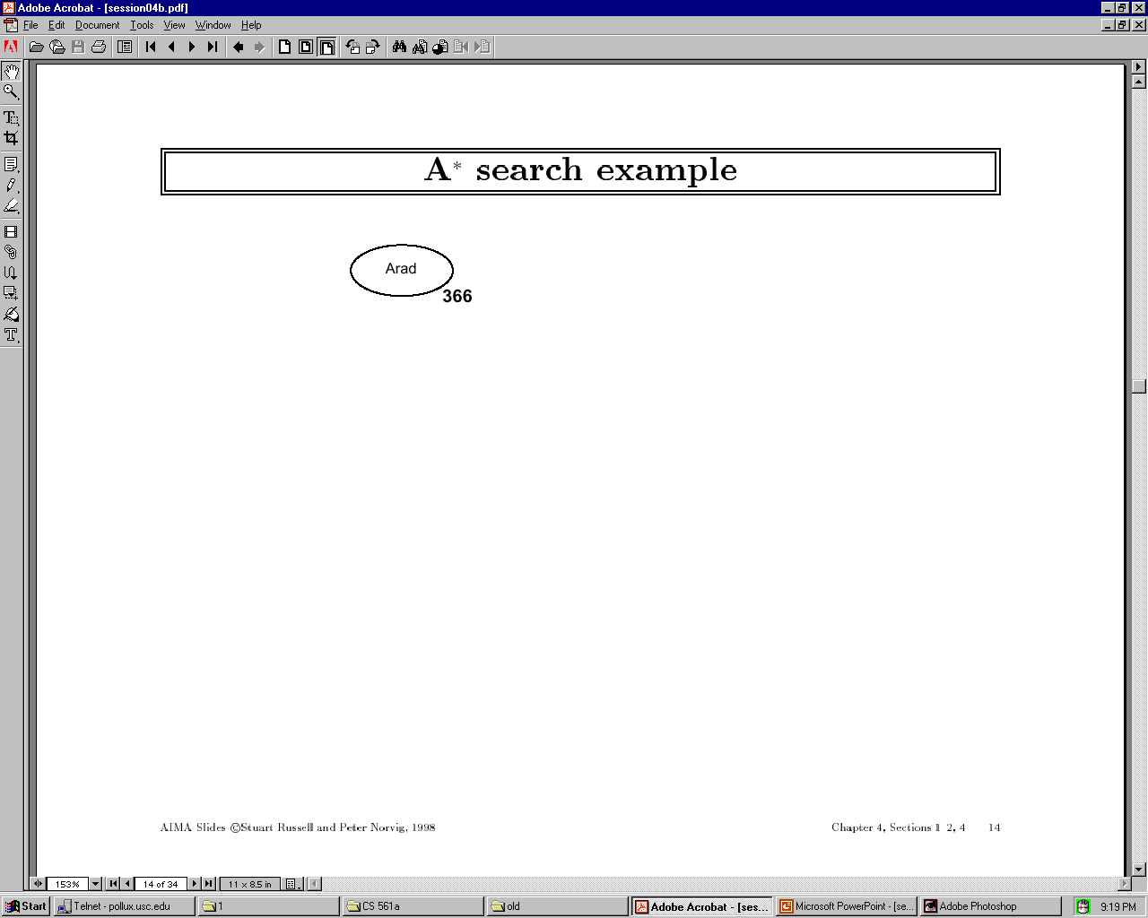

Slide 25
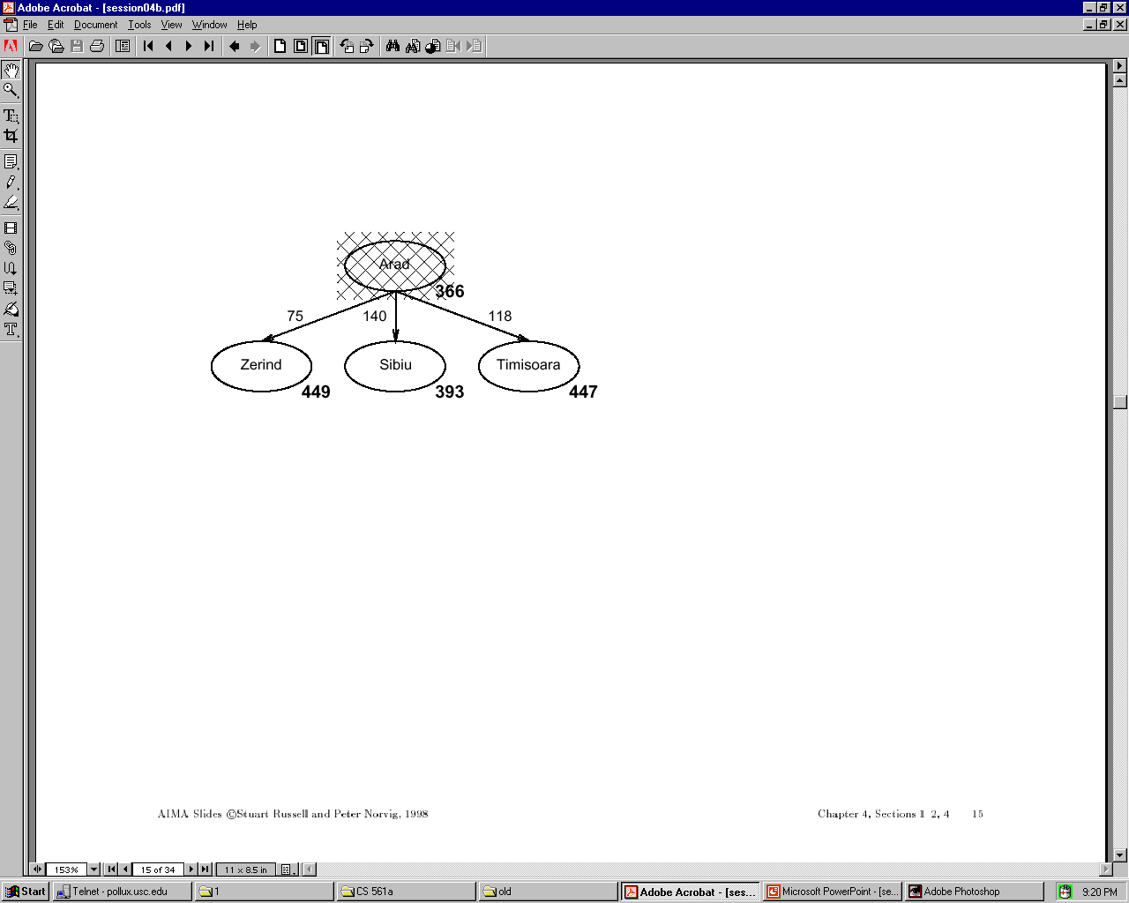

Slide 26
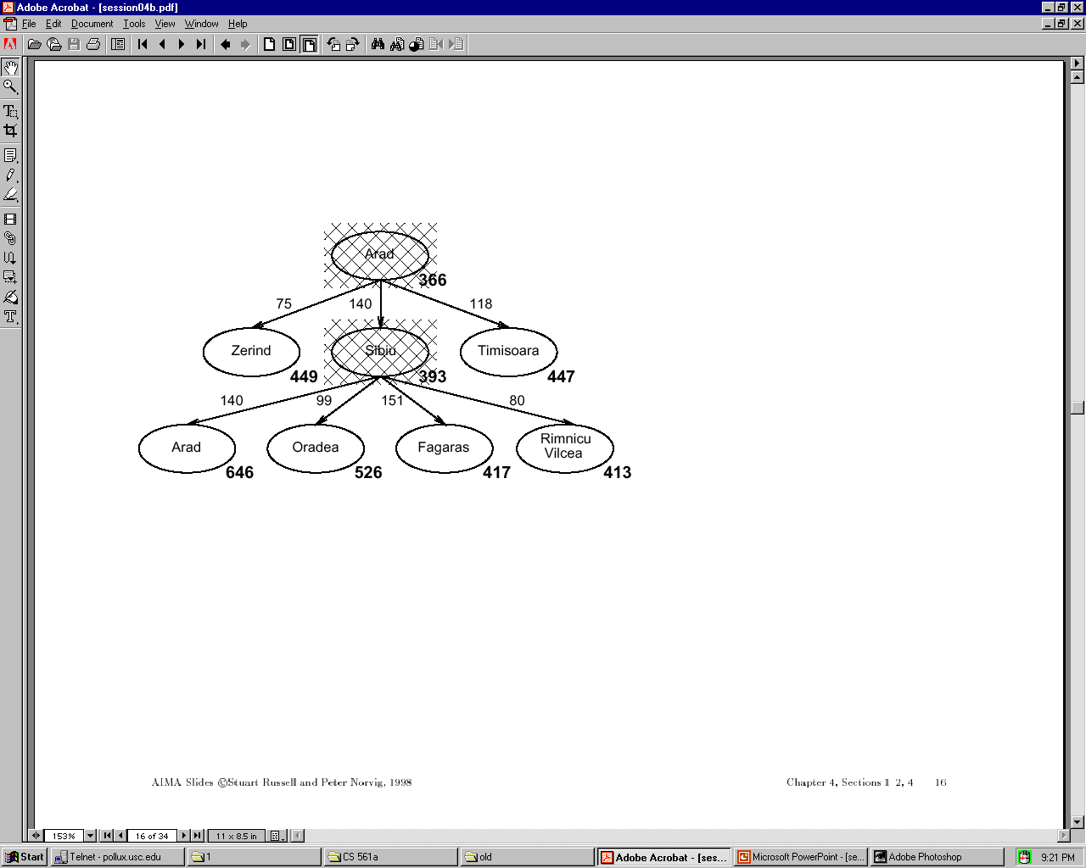

Slide 27
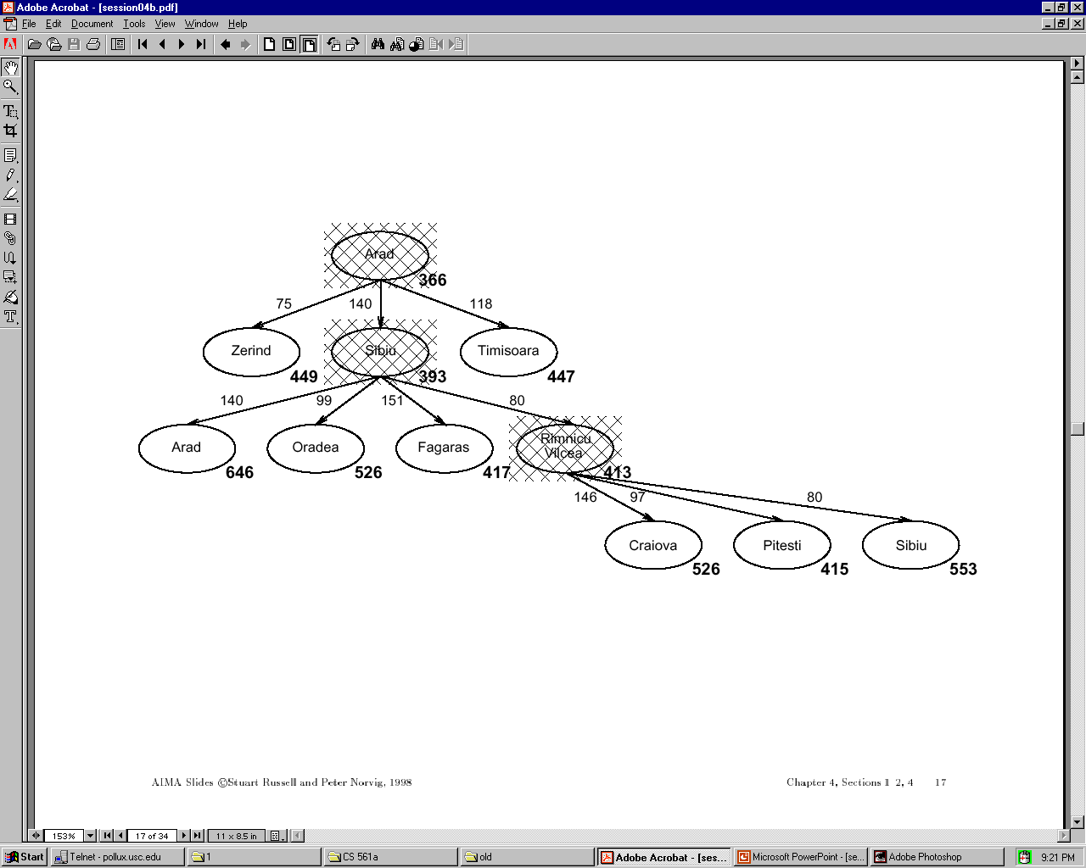

Slide 28
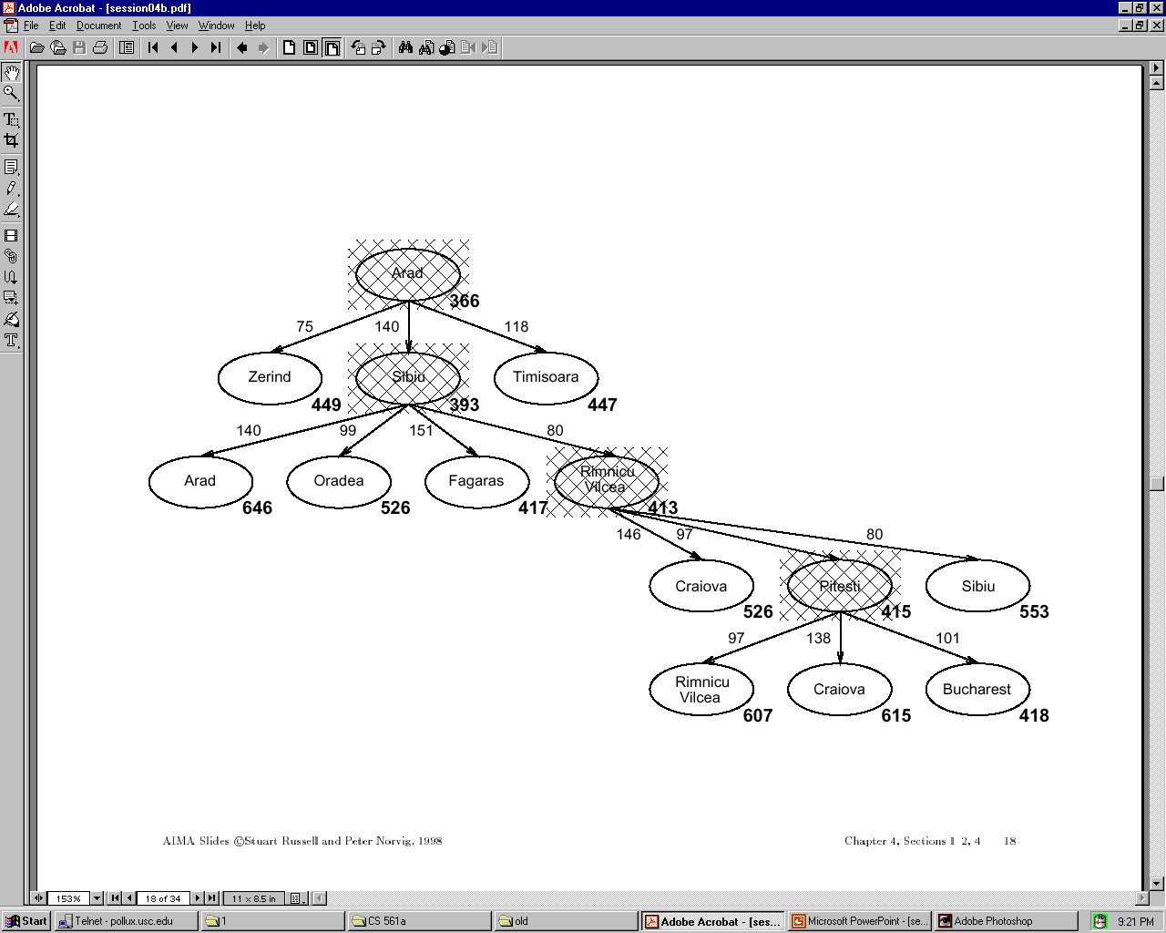

Slide 29
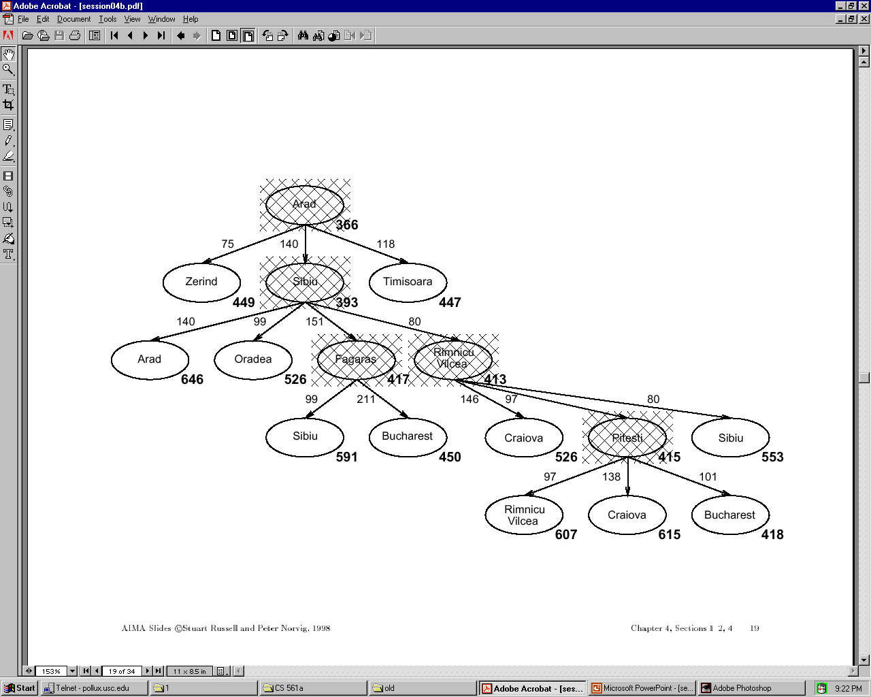

Slide 30
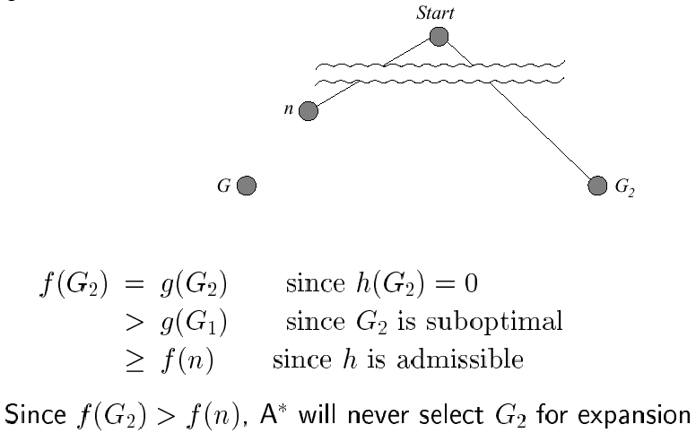
Optimality of A* (standard proof)
Suppose some suboptimal goal G₂ has been generated and is in the queue. Let n be an unexpanded node on a shortest path to an optimal goal G₁.
1

Slide 31
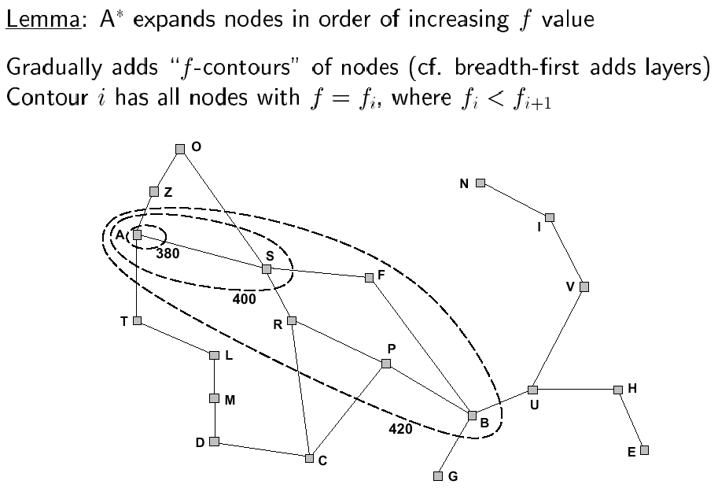
Optimality of A* (more useful proof)

Slide 32
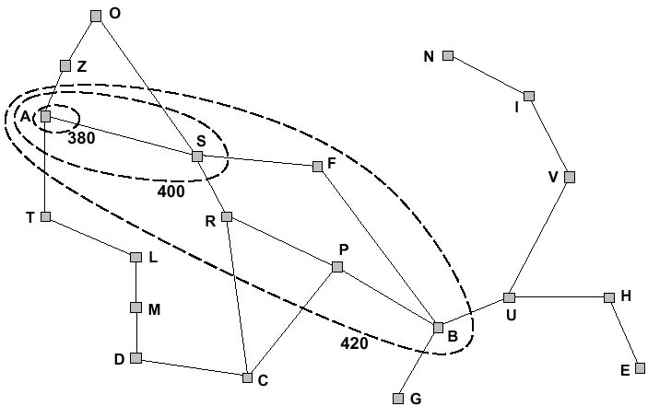
f-contours
How do the contours look like when h(n) =0?

Slide 33
Properties of A*
Complete?
Time?
Space?
Optimal?

Slide 34
Properties of A*
Complete? Yes, unless infinitely many nodes with f ≤ f(G)
Time? Exponential in [(relative error in h) x (length of solution)]
Space? Keeps all nodes in memory
Optimal? Yes – cannot expand f_{i+1} until f_{i} is finished

Slide 35
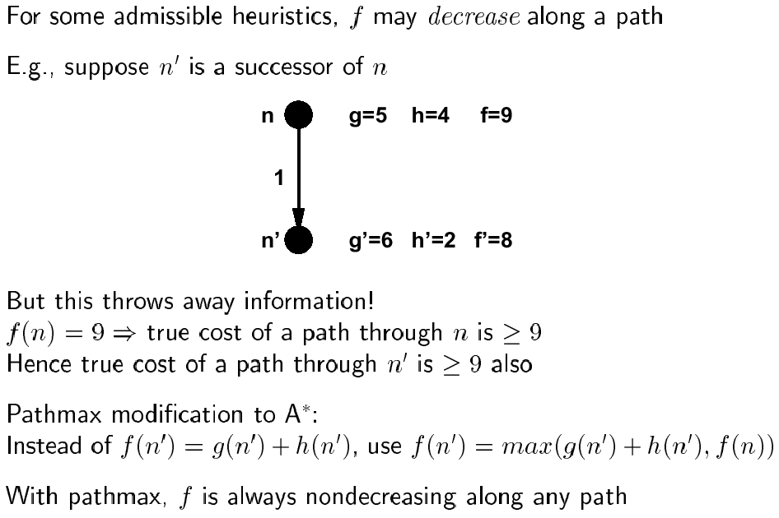
Proof of lemma: pathmax

Slide 36
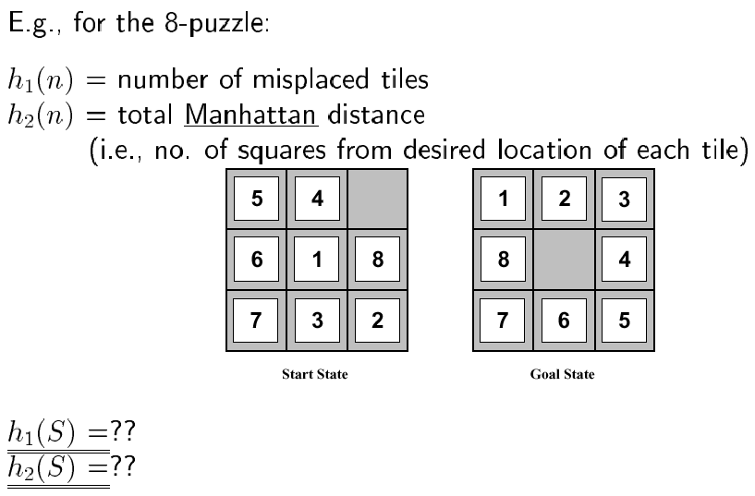
Admissible heuristics

Slide 37
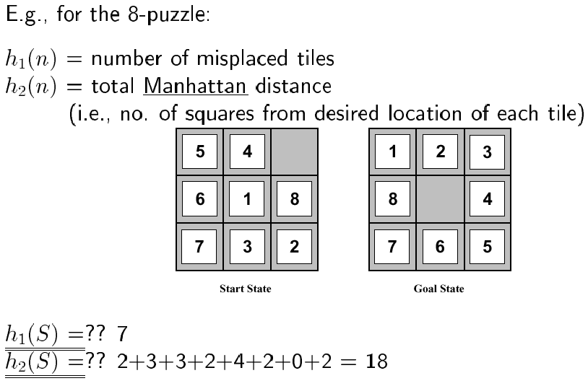
Admissible heuristics

Slide 38
Relaxed Problem
Admissible heuristics can be derived from the exact solution cost of a relaxed version of the problem.
If the rules of the 8-puzzle are relaxed so that a tile can move anywhere, then h₁(n) gives the shortest solution.
If the rules are relaxed so that a tile can move to any adjacent square, then h₂(n) gives the shortest solution.

Slide 39
Next time
Iterative improvement
Hill climbing
Simulated annealing

